Slide 1
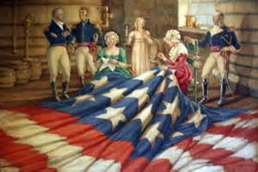
3-2-1
What 3 things do you see?
What 2 things draw your attention?
What question would you ask one of the people in the image?

Slide 2
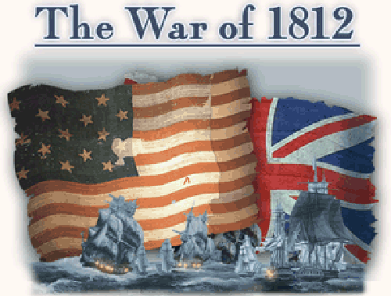
Notes:
The War of 1812
Although its events inspired one of the nation’s most famous patriotic songs, the War of 1812 is a relatively little-known war in American history. Despite its complicated causes and inconclusive outcome, the conflict helped establish the credibility of the young United States among other nations. It fostered a strong sense of national pride among the American people, and those patriotic feelings are reflected and preserved in the song we know today as the U.S. national anthem.
Britain’s defeat at the 1781 Battle of Yorktown marked the conclusion of the American Revolution and the beginning of new challenges for a new nation. Not even three decades after the signing of the Treaty of Paris, which formalized Britain’s recognition of the United States of America, the two countries were again in conflict. Resentment for Britain’s interference with American international trade, combined with American expansionist visions, led Congress to declare war on Great Britain on June 18, 1812.
In the early stages of the war, the American navy scored victories in the Atlantic and on Lake Erie while Britain concentrated its military efforts on its ongoing war with France. But with the defeat of Emperor Napoléon’s armies in April 1814, Britain turned its full attention to the war against an ill-prepared United States.
Source: http://amhistory.si.edu/starspangledbanner/the-war-of-1812.aspx

Slide 3
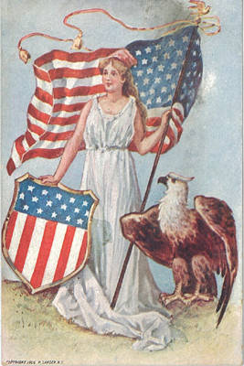
Why is the War of 1812 Important?
helped establish credibility of the young U.S. among other nations
fostered a strong sense of national pride
War Declared June 18, 1812
Resentment over Britain’s interference with American international trade
1812 Clip

Slide 4
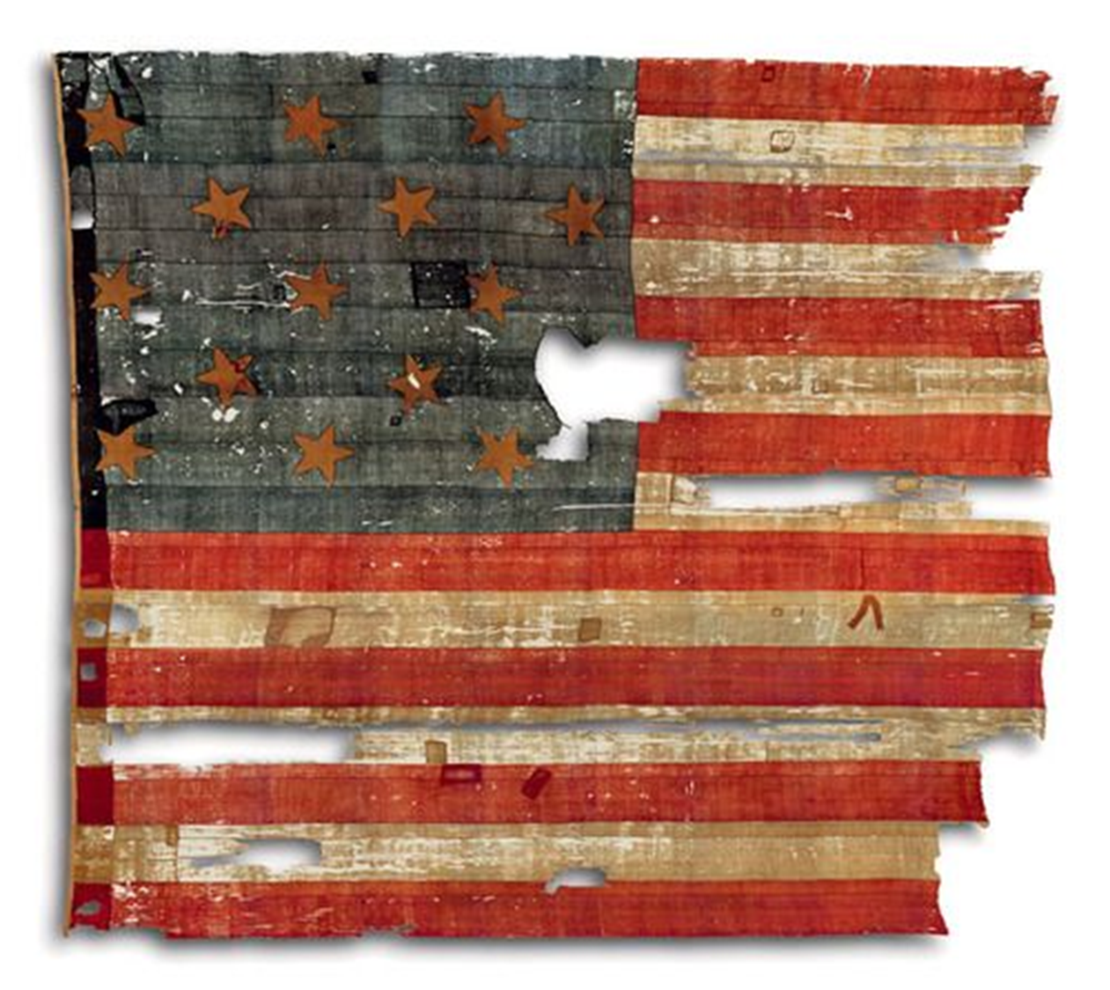
Star Spangled Banner
Mary Pickersgil & crew= Caroline (13 daughter) Eliza & Margaret Young (nieces), & Grace Wisher 13 yr old indentured servant
Completed 2 flags in 7 wks.
30 x 42 feet
Notes:
Making the Flag
Explore The Interactive Flag
In the summer of 1813, Mary Pickersgill (1776–1857) was contracted to sew two flags for Fort McHenry in Baltimore, Maryland. The one that became the Star-Spangled Banner was a 30 x 42–foot garrison flag; the other was a 17 x 25–foot storm flag for use in inclement weather. Pickersgill, a thirty-seven-year-old widow, was an experienced maker of ships’ colors and signal flags. She filled orders for many of the military and merchant ships that sailed into Baltimore’s busy port.
Helping Pickersgill make the flags were her thirteen-year-old daughter Caroline; nieces Eliza Young (thirteen) and Margaret Young (fifteen); and a thirteen-year-old African American indentured servant, Grace Wisher. Pickersgill’s elderly mother, Rebecca Young, from whom she had learned flagmaking, may have helped as well.
Pickersgill and her assistants spent about seven weeks making the two flags. They assembled the blue canton and the red and white stripes of the flag by piecing together strips of loosely woven English wool bunting that were only 12 or 18 inches wide.
Source: http://amhistory.si.edu/starspangledbanner/making-the-flag.aspx

Slide 5
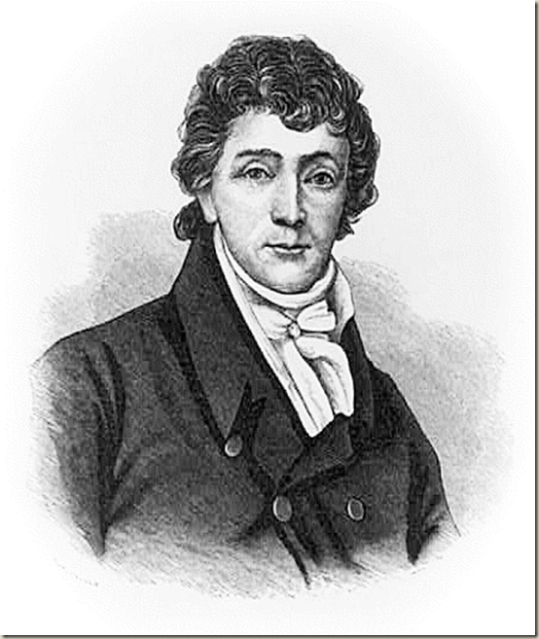
History of the Star Spangled Banner
Lyrics composed on September 14, 1814- Francis Scott Key
Composed lyrics after witnessing the massive overnight British bombardment of Fort McHenry in Maryland during the War of 1812
Key, an American lawyer, watched the siege while under detainment on a British ship and penned the famous words after observing with awe that Fort McHenry's flag survived the 1,800-bomb assault.

Slide 6
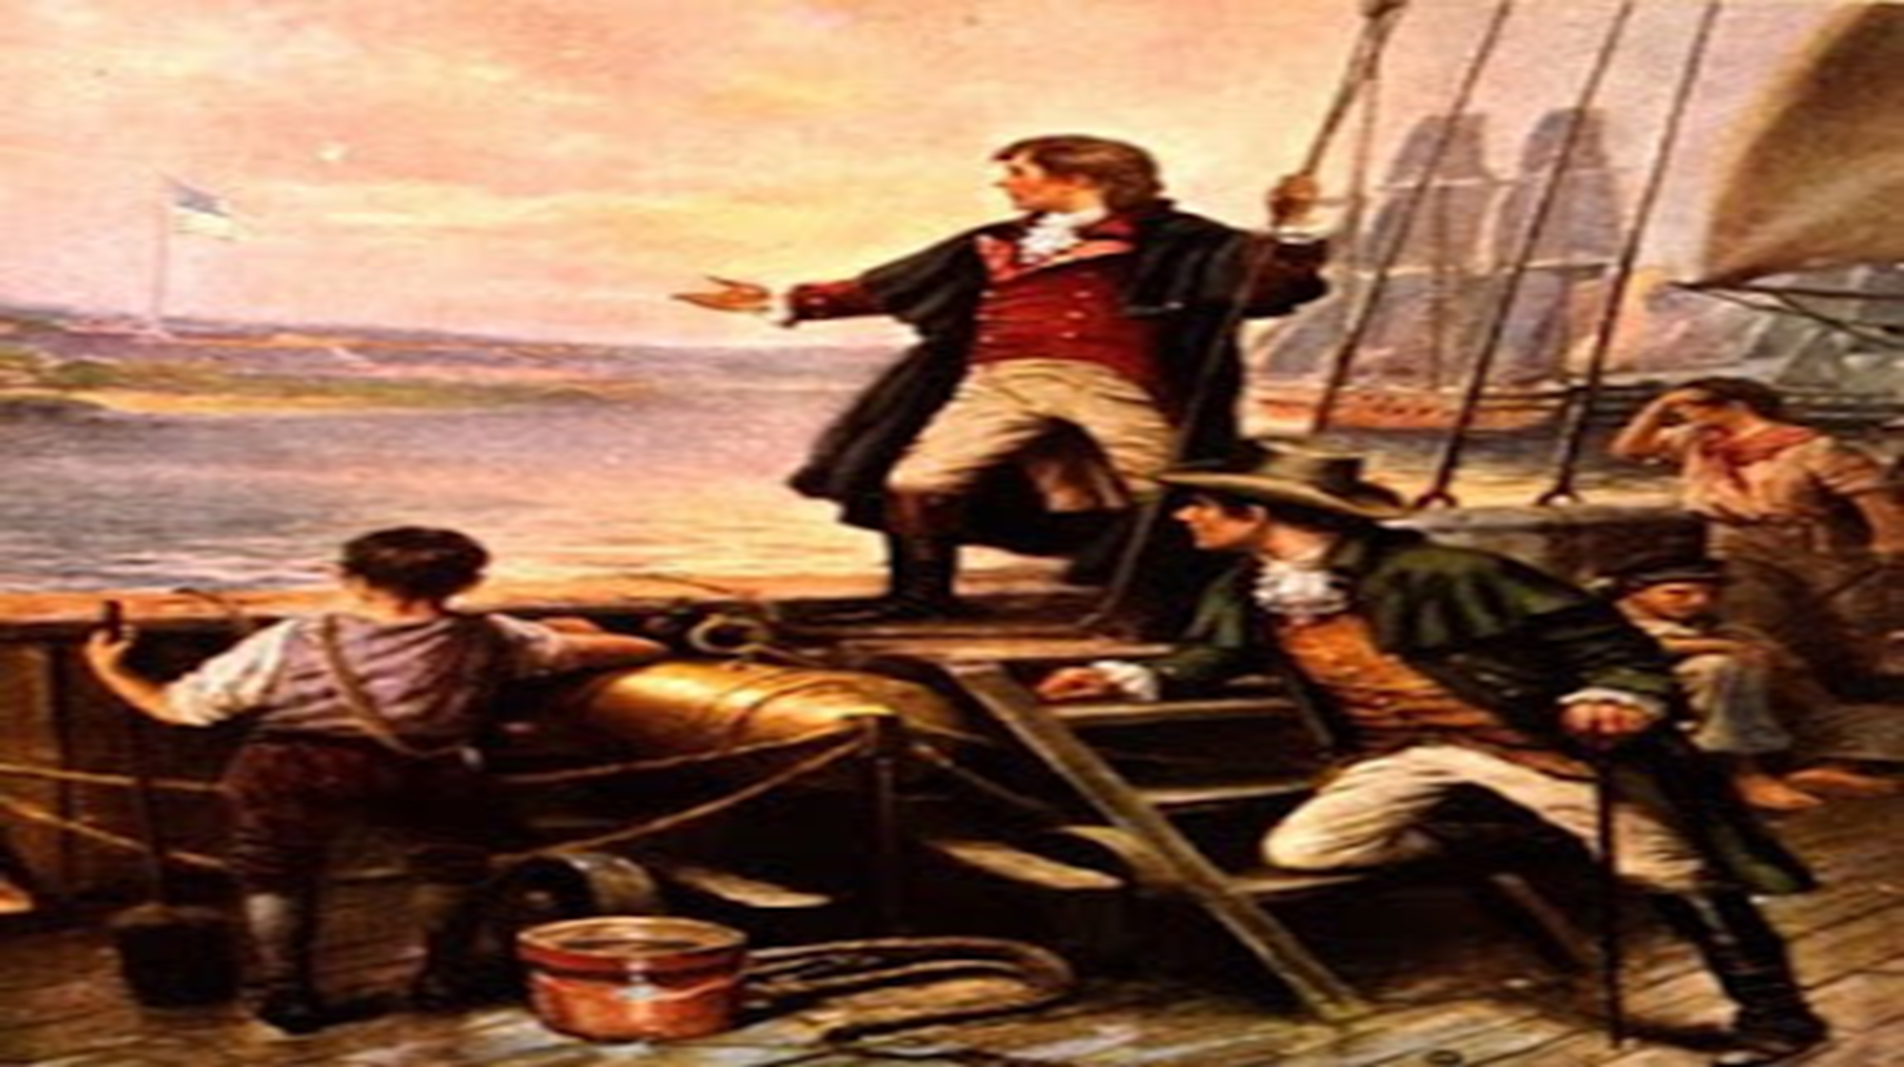
Notes:
http://2.bp.blogspot.com/-4QxEIbXRSSQ/ThII5GXpnOI/AAAAAAAADGU/0kr27wP7MUU/s320/francis_scott_key_2.jpg
http://www.nps.gov/fomc/historyculture/francis-scott-key.htm

Slide 7
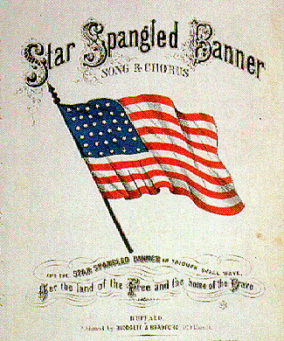
The
Notes:
The Lyrics
Sing The National AnthemFrancis Scott Key was a gifted amateur poet. Inspired by the sight of the American flag flying over Fort McHenry the morning after the bombardment, he scribbled the initial verse of his song on the back of a letter. Back in Baltimore, he completed the four verses (PDF) and copied them onto a sheet of paper, probably making more than one copy. A local printer issued the new song as a broadside. Shortly afterward, two Baltimore newspapers published it, and by mid-October it had appeared in at least seventeen other papers in cities up and down the East Coast.
This 19th century version (MP3) of the Star-Spangled Banner was performed on original instruments from the National Museum of American History's collection. Arranged by G. W. E. Friederich, the music is played as it would have been heard in 1854.
Source: http://amhistory.si.edu/starspangledbanner/the-lyrics.aspx

Slide 8
Notes:
A Family Song
During the 19th century, “The Star-Spangled Banner” became one of the nation’s best-loved patriotic songs, performed during both public events and more personal gatherings.
Source: http://amhistory.si.edu/starspangledbanner/the-lyrics.aspx

Slide 9
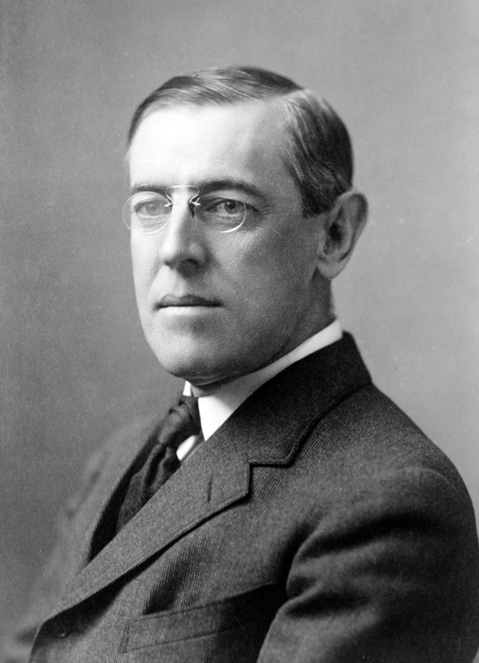
History continued
After circulating as a handbill, the patriotic lyrics were published in a Baltimore newspaper on September 20, 1814.
Key's words were later set to the tune of "To Anacreon in Heaven," a popular English song.
Throughout the 19th century, "The Star-Spangled Banner" was regarded as the national anthem by most branches of the U.S. armed forces and other groups
Became official in 1916, with the signing of an executive order by President Woodrow Wilson,
In March 1931, Congress passed an act confirming Wilson's presidential order & on March 3 President Hoover signed it into law.

Slide 10
http://www.youtube.com/watch?v=P-M8E7zeo70

Slide 11
Brain Dump
What thoughts, emotions, ideas, come to mind when you hear the Star Spangled Banner?

Slide 12
Star Spangled Banner Lyrics: Marking the Text
Number the verses
Circle key words or phrases (partner A)
Underline evidence/claims (partner B)
Share with an elbow partner what you circled/underlined
Summarize the main idea of the song in 4-5 sentences

Slide 13
SBB as Primary Source
Directions: Respond to the following questions in 4-5 sentences
What is the tone of the lyrics? Explain your response and list specific words that support your claim.
What role do national anthems play in creating and expanding nationalism? Explain thoroughly.

