Slide 1
SHARING THE
LINDY HOP EXPERIENCE WITH OUR STUDENTS
(Harlem Renaissance, Great Black Migration)
By Julia Loving

Slide 2
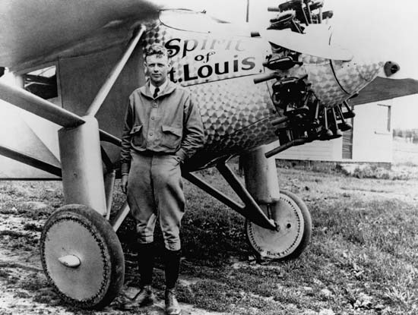
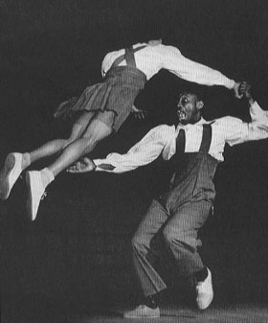
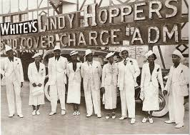
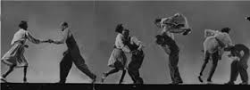
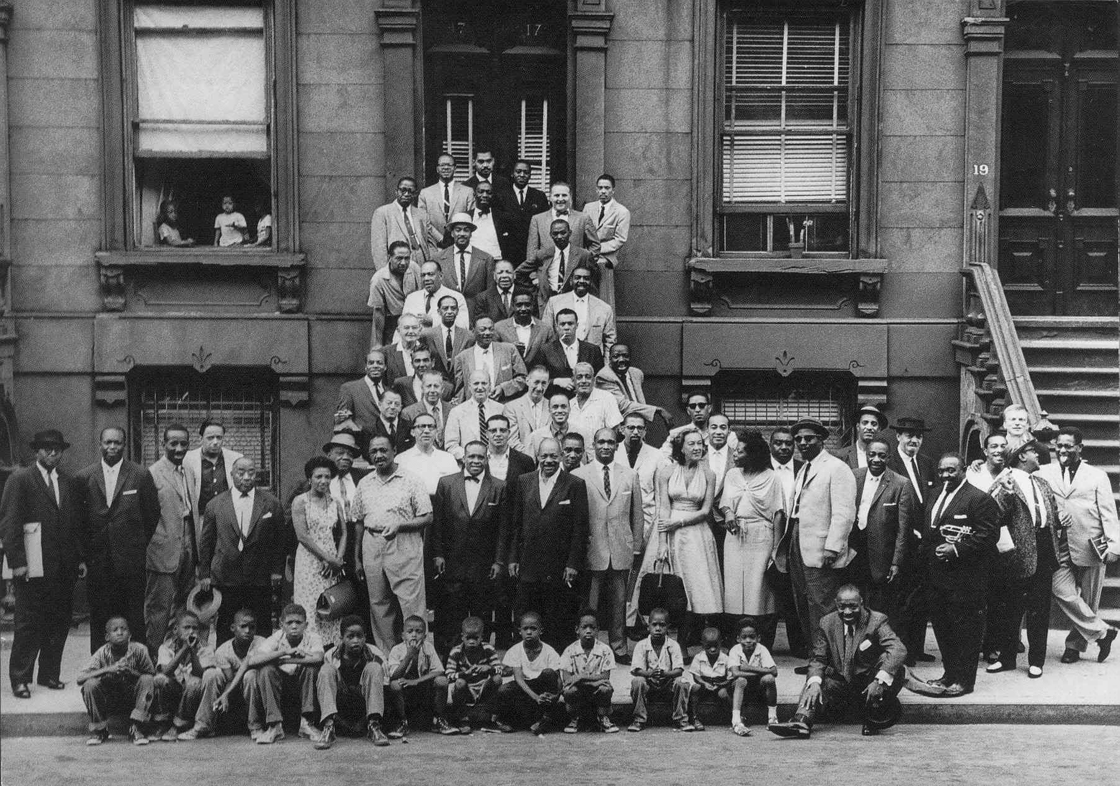

Slide 3
Lindy Hop Solo Moves
Boogie Forwards (Snap Fingers Forward) 3X
Fishtail (Back left leg, then right leg)3X
Knee Taps (Clap on each leg around in a circle) 2X
Shorty George (Forward)3X
Boogie Backs (Kick & Clap Back)3X
Box Steps (Cross Right foot over left and step back)3X
Fall of the Log (kick left, kick right)3X
Scarecrow (kick and stand like a scarecrow)3X
Suzie Q’s (twist to the left and then the right around circle)1X
Charleston (Start with left leg step back, kick with your right)3X
Spank the Baby (Tap your behind and knee kick)1Xaround
Bee’s Knees (Crisscross left hand to right hand)till end

Slide 4
Great Lindy Websites
http://www.youtube.com/watch?v=B7fppGFXstM
http://www.savoystyle.com/
http://www.lindycircle.com/history/lindy_hop/
http://dancing.org/lindy-what-is.html
http://www.nytimes.com/2014/05/24/nyregion/lindy-hop-is-back-thanks-in-part-to-sweden.html?_r=0
http://theharlemswingdancesociety.blogspot.com/
http://www.savoystyle.com/frankie_manning.html
http://www.frankiemanningfoundation.org/frankie/videos.html
http://www.youtube.com/watch?v=ahoJReiCaPk
http://www.youtube.com/watch?v=IH1Fru-RttA

Slide 5
Popular Lindy Dance Songs
https://www.lindygroove.com/djs
http://www.ithacaswingdance.com/lindyhopmusic.html
http://ickeroo.blogspot.com/2012/03/top-10-swing-songs-every-beginner.html
http://www.swingornothing.com/more-beginning-lindy-hop-favorites/
http://www.allmusic.com/album/all-time-greatest-swing-era-songs-mw0002055772

