Slide 1
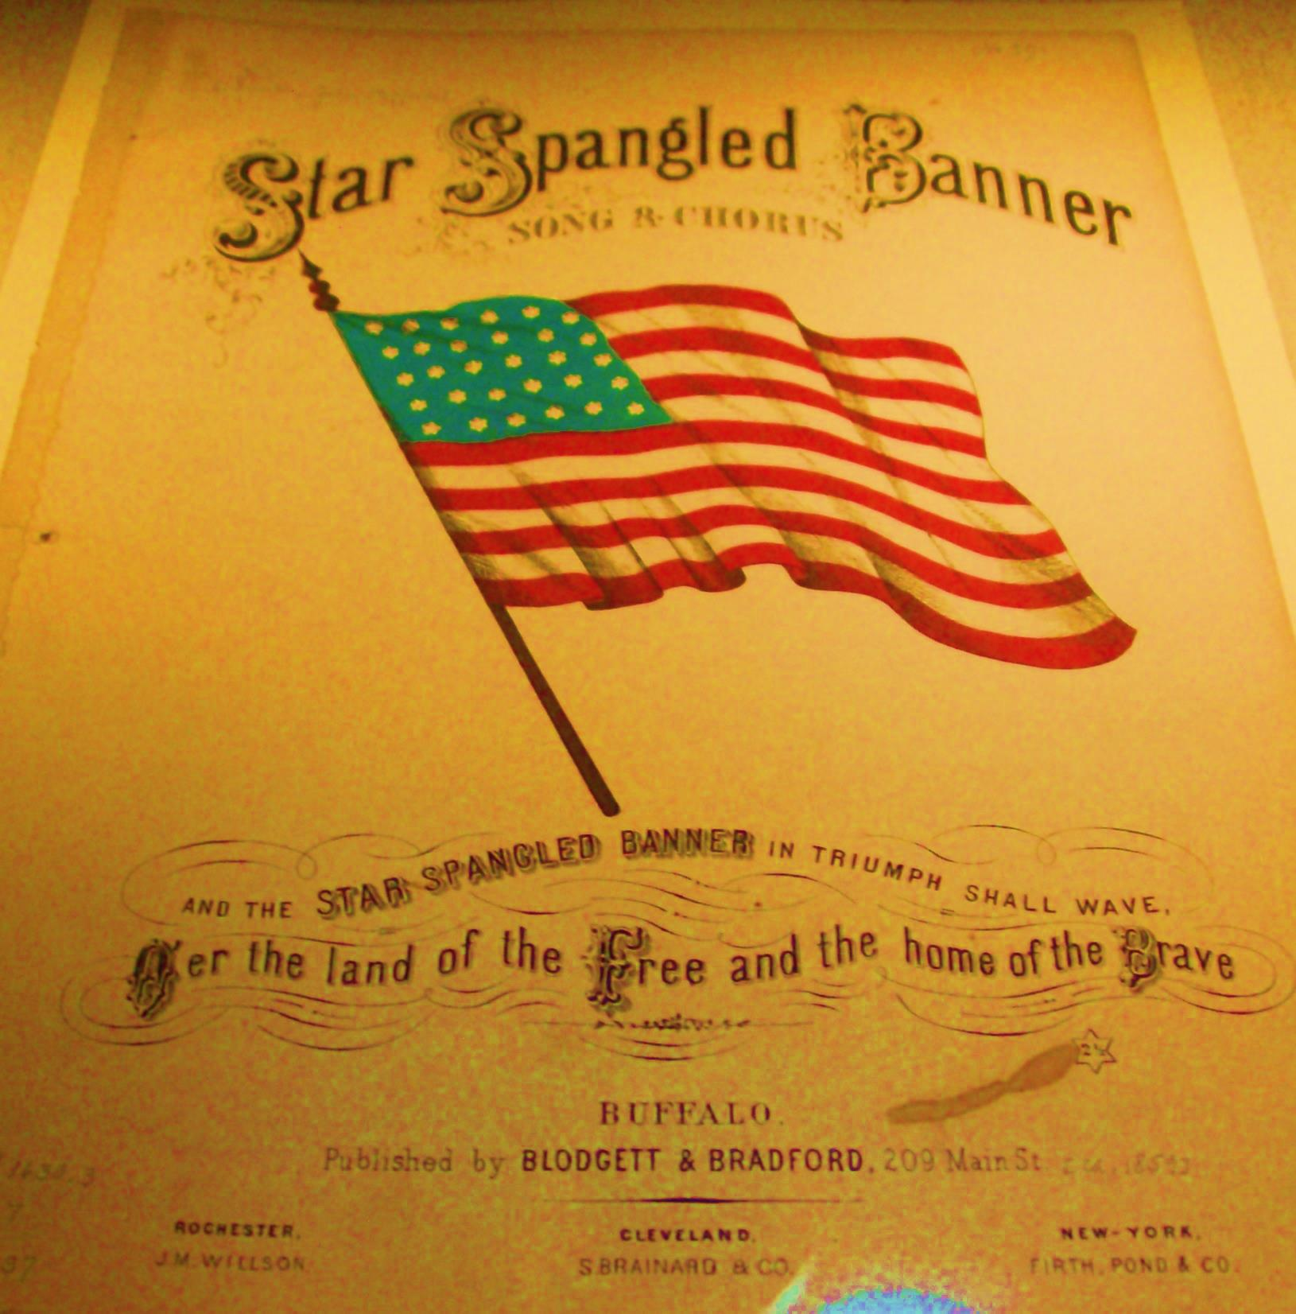
Freedom Week
A School-Wide Celebration
for
Celeste Henkel Elementary
September 8-12, 2014
NEH 2014 – Banner Moments Curricular Project
University of Maryland, College Park, MD
Janet H. Berry

Slide 2


Slide 3
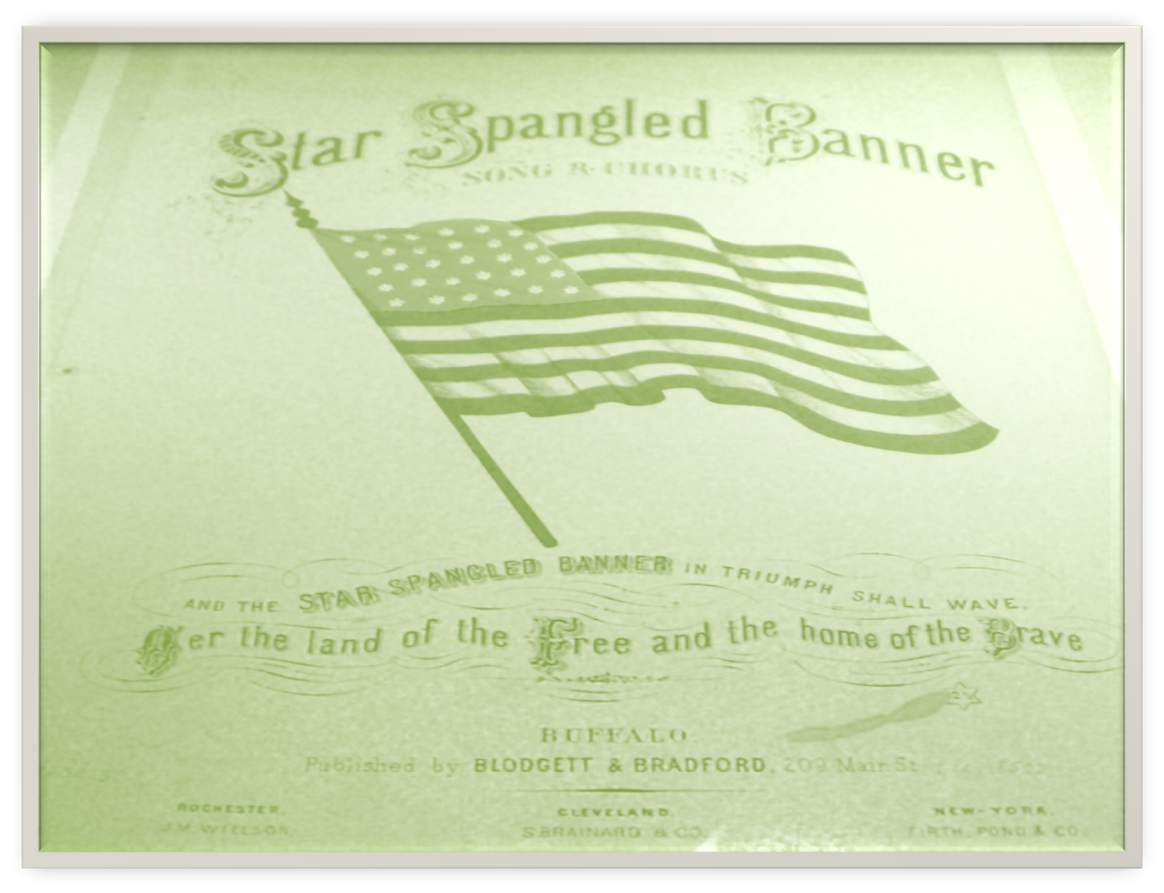
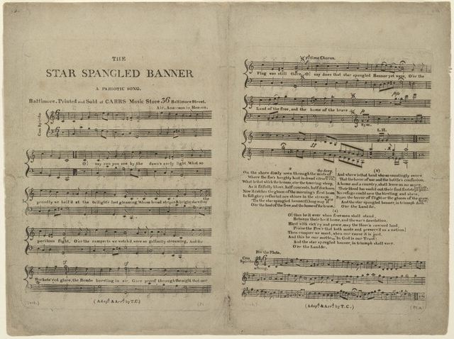

Slide 4
Outline:
Singing of “The Star-Spangled Banner”
Think-pair-share/Elbow partner
National Endowment for the Humanities
Banner Moments Institute
Proposal:
Monday, Sept. 8th – Friday, Sept. 12, 2014
During morning announcements, Patriotic music
will be shared and a student dialogue representing
life as it was in the early 1800’s as they share the
guiding question and focus word(s) for the day.
Lessons will be available from the http://starspangledmusic.org site.

Slide 5
Kindergarten: Stars/Colors
Songs - “Yankee Doodle” and “Do Your Ears Hang Low”
1st Grade: Colors/Flag
Songs – “You’re a Grand Old Flag” and “My Country Tis’ of Thee”
2nd Grade: Flags of our Nation through time
Songs - “This Land is Your Land” and “Battle Hymn of the Republic”
3rd Grade: Community/Iredell County
Songs – “America the Beautiful” and “God Bless America”
4th Grade: North Carolina
Songs – “Old North State” and “When Johnny Comes Marching”
5th Grade: USA
Songs – “Star-Spangled Banner” and “This is My Country”
*In addition to resources on your curriculum guides, here are a few I learned about or created this summer.

Slide 6
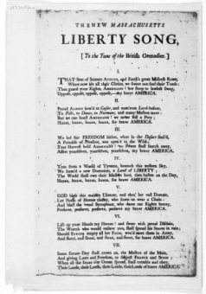
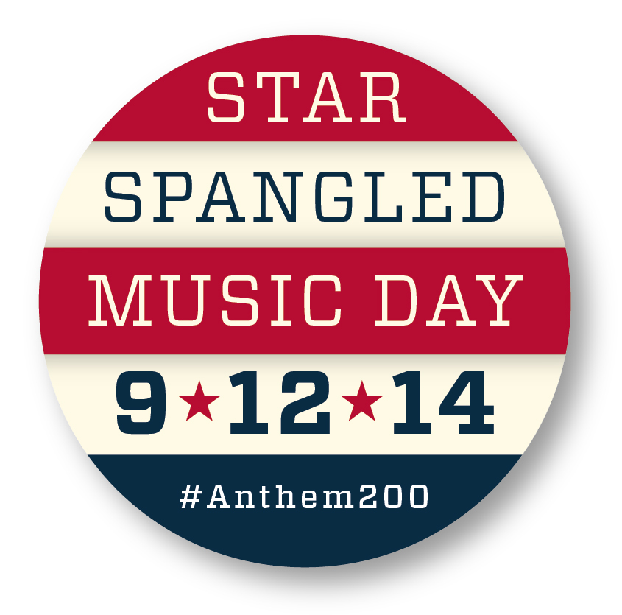
Monday 9/8:
Guiding Question - Why did we go to War?
Focus Words - Freedom/Independence
Lesson/Activities:
3rd Grade Standards:
Social Studies
3.C&G 2.1
Exemplify how citizens contribute politically, socially and economically to their community.
4th Grade Standards:
http://www.loc.gov/collection/songs-ofamerica/?q=&fa=location%3Anorth+carolina&sb=date
ELA – http://starspangledmusic.org/the-music-of-poetry-decoded
4.RL.2. Determine a theme of a story, drama, or poem from details in the text; summarize the text.
4.RL.3. Describe in depth a character, setting, or event in a story or drama, drawing on specific details in the text (e.g., a character’s thoughts, words, or actions).
4.H.1.4 Analyze North Carolina’s role in major conflicts and wars from the Pre-colonial period
through Reconstruction. (War of 1812 – Captain Otway Burns and the Snapdragon)
http://swansborohistory.blogspot.com/p/otway-burns-and-his-snapdragon.html
https://archive.org/details/captainotwayburn01burn

Slide 7


5th Grade Standards: The Music of Poetry: Decoded
Lessons online at http://starspangledmusic.org/the-music-of-poetry-decoded/
ELA – 5.RL.5.2 Determine a theme of a story, drama, or poem from details in the text, including how characters in a story or drama respond to challenges or how the speaker in a poem reflects upon a topic; summarize the text.
5.RL.5.6 Describe how a narrator’s or speaker’s point of view influences how events are described.
Social Studies- 5. C.1.4
Understand how cultural narratives (legends, songs, ballads, games, folk tales and art forms) reflect the lifestyles, beliefs and struggles of diverse ethnic groups.
Lesson 1:
Paul Revere's Ride Paperback – March 1, 1996
by Henry Wadsworth Longfellow (Author), Ted Rand (Illustrator)
Lesson 2:
The Star-Spangled Banner in Translation by Elizabeth Raum
Audible book available online at amazon.com

Slide 8
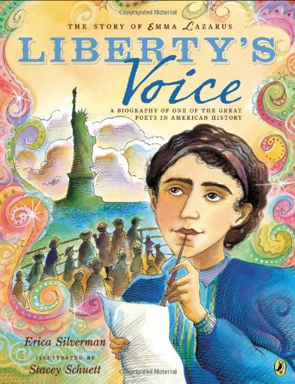

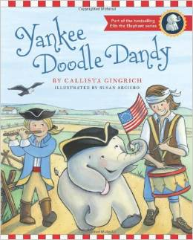
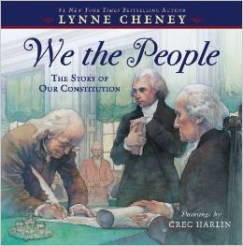
Lesson 3:
Teacher Resources:
Books for K-2
Yankee Doodle Dandy by (Ellis the Elephant)
by Callista Gingrich (Author), Susan Arciero (iIlustrator)
We the People: The Story of Our Constitution
by Lynne Cheney (Author), Greg Harlin (Illustrator)
Liberty's Voice: The Emma Lazarus Story Paperback – May 15, 2014
by Erica Silverman (Author), Stacey Schuett (Illustrator)

Slide 9
Video clips-http://www.naval-war-of-1812-illustrated.org/
Websites-
http://unctv.pbslearningmedia.org/search/?q=War+of+1812&selected_facets=supplemental_curriculum_hierarchy_nodes_exact%3A4648&selected_facets=resource_distribution_type_exact%3A0&page=2
http://warof1812.thinkport.org/#interactive-map.html
http://www.teachushistory.org/war-1812-hartford-convention/overview
http://www.mdhs.org/digitalimage/view-bombardment-fort-mchenry-near-baltimore-british-fleet-taken-observatory-under-comm
http://unctv.pbslearningmedia.org/resource/1570d215-8835-41d3-a1a0-c3a4fbfb1b1d/caustic-causes-lesson-plan/
http://www.pbs.org/ktca/liberty/teachers.html
http://warof1812archaeology.blogspot.com/
Extension:
Military accounts:
https://archive.org/stream/citizensoldiersa01hick#page/78/mode/2up
http://www.fortmchenrylibrary.org/index.cfm?action=archival

Slide 10
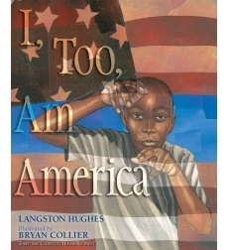
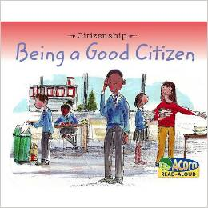
Tuesday 9/9:
Guiding Question - What is an American?
Focus Word – Citizenship
Lesson/Activities:
Teacher Resources: http://teacher.scholastic.com/activities/immigration/index.htm
http://app.discoveryeducation.com/search?Ntt=Citizenship#selItemsPerPage=60&intCurrentPage=0&No=0&N=18341%252B18340&Ne=18339&Ntt=Citizenship&Ns=&Nr=&browseFilter=&indexVersion=&Ntk=All&Ntx=mode%252Bmatchallpartial
Books-
I, Too, Am America
By Langston Hughes, illustrated by Bryan Collier
Being A Good Citizen (Acorn Read Aloud: Citizenship) Paperback – August 15, 2009
by Adrian Vigliano (Author), Rebecca Rissman (Editor)

Slide 11
Video clips-
https://www.youtube.com/watch?v=g3HkHeRbQvA&list=PL1FC5F2F2D2763367&index=2
Websites-
http://edsitement.neh.gov/lesson-plan/oh-say-can-you-see-what-star-spangled-banner-means#sect-introduction

Slide 12

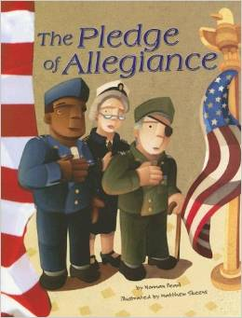
Wednesday 9/10:
Guiding Question - What do our National Symbols
mean to me?
Focus Word - Liberty
Lesson/Activities:
http://starspangledmusic.org
Teacher Resources:
Books-
The Bald Eagle by Norman Pearl
The Pledge of Allegiance by Norman Pearl

Slide 13
Video clips- http://video.pbs.org/video/2184181419/
Websites-
http://edsitement.neh.gov/lesson-plan/stars-and-stripes-forever-flag-facts-flag-day#sect-introduction
http://www.americaslibrary.gov/jb/modern/jb_modern_birth_1.html
http://www.pbs.org/ktca/liberty/teachers.html

Slide 14
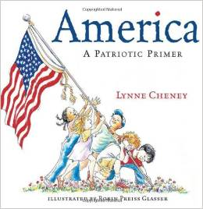
Thursday 9/11:
Guiding Question - Why is today Patriot Day and
National Day of Service and Remembrance?
Focus Word – Patriotism
Lesson/Activities:
http://starspangledmusic.org
Teacher Resources:
Books- America: A Patriotic Primer by Lynne Cheney
Websites-
http://patriotweek.org/activities-projects-2
http://patriotweek.org/historical-documents-2

Slide 15
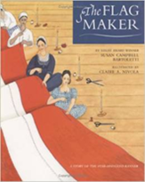
Friday 9/12:
Guiding Question - Why the ‘Star-Spangled Banner’?
Focus Words– Identity/Song/Flag
Lesson/Activities:
K-2 The Flag Maker by Susan Campbell Bartoletti
online lesson plan - http://amhistory.si.edu/ourstory/pdf/starspangled/reading_the_flag_maker.pdf
STUDENT PERFORMANCE CRITERIA
■ Discussion exhibits understanding of story and historical details.
■ Discussion exhibits understanding of vocabulary in the context of the story.
STANDARDS:
K-4 Historical Thinking Standards
2D: Read historical narratives imaginatively.
2H. Draw upon the visual data presented in photographs, paintings, cartoons, and
architectural drawings.
3C. Analyze historical fiction.
3F: Analyze illustrations in historical stories.
K-4 Historical Content Standards
4E: The student understands national symbols through which American values and
principles are expressed.

Slide 16
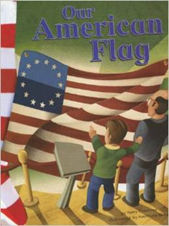
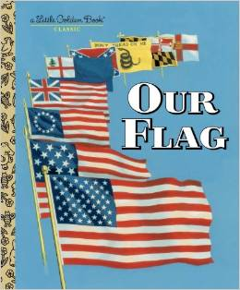
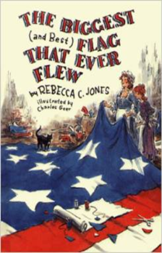
Language Arts Standards
1. Students read a wide range of print and non-print texts to build an understanding of
texts, of themselves, and of the cultures of the United States and the world; to
acquire new information; to respond to the needs and demands of society and the
workplace; and for personal fulfillment. Among these texts are fiction and
nonfiction, classic and contemporary works.
7. Students conduct research on issues and interests by generating ideas and
questions, and by posing problems. They gather, evaluate, and synthesize data from
a variety of sources (e.g., print and non-print texts, artifacts, people) to communicate
their discoveries in ways that suit their purpose and audience.
21st-Century Skills
Learning and Innovation Skills
■ Critical Thinking and Problem Solving
K-2
Our American Flag by Mary Firestone
Our Flag by Carl Memling, Illustrated by Stephen Cook
The Biggest Flag That Ever Flew by Rebecca C. Jones, Illustrated by Charles Geer

Slide 17

3-5
Teacher Resources:
Books:
The Star-Spangled Banner in Translation by Elizabeth Raum
Audible book available
Websites:
http://edsitement.neh.gov/lesson-plan/oh-say-can-you-see-what-star-spangled-banner-means#sect-introduction
http://keycam.com/about-key

Slide 18
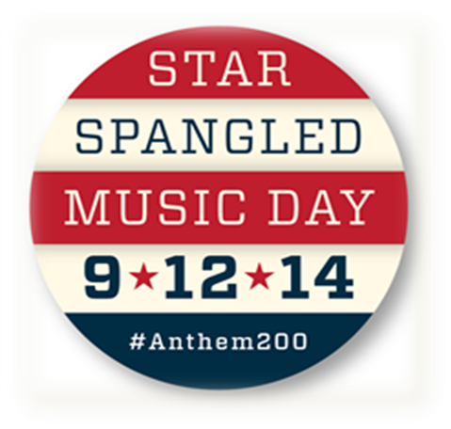
Red, White and Blue Day
Grade Level Presentations
Celebration Concert
‘O Say Can You See’

