Slide 1
Historical InvestigATION qUESTION
What were important patriotic symbols during the period of the early republic and what did they represent?
How did those symbols become replaced by the Star Spangled Banner song and the flag?

Slide 2
Bald Eagle
It took 6 years of arguing by our forefathers to come up with a national emblem. We all know how
Benjamin Franklin wanted the turkey, because the turkey was a domestic, useful and tasty. But the turkey wasn't impressive enough for most of our forefathers.
On the other hand, many other nations were using eagles also.
Franklin pointed out, "the eagle is a bird of bad moral character" because he was a scavenger that stole food from other birds.
Bald Eagle vs. Golden Eagle
Notes:
So a compromise was reached in 1782 and Congress chose the BALD EAGLE, rather than the Golden Eagle (most commonly used by other countries) because the Bald Eagle was unique to North America and not used by other countries, while still having impressive nobility. Due to land mismanagement and other factors, the Bald Eagle population was almost extinct. In 1940 Congress passed a law forbidding the capture or killing of bald eagles. Since that time, with the banning of DDT in 1973 and other conservation acts, the Bald Eagle has made a comeback in America.
http://www.brownielocks.com/patrioticsymbols.html

Slide 3
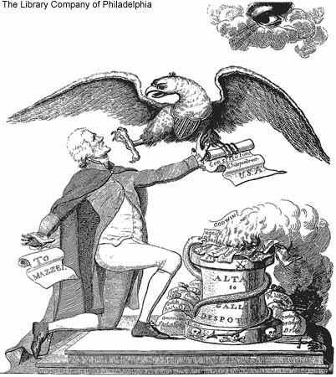
Notes:
http://sites01.lsu.edu/wp/graduateschool/files/2014/03/Jefferson5.jp

Slide 4
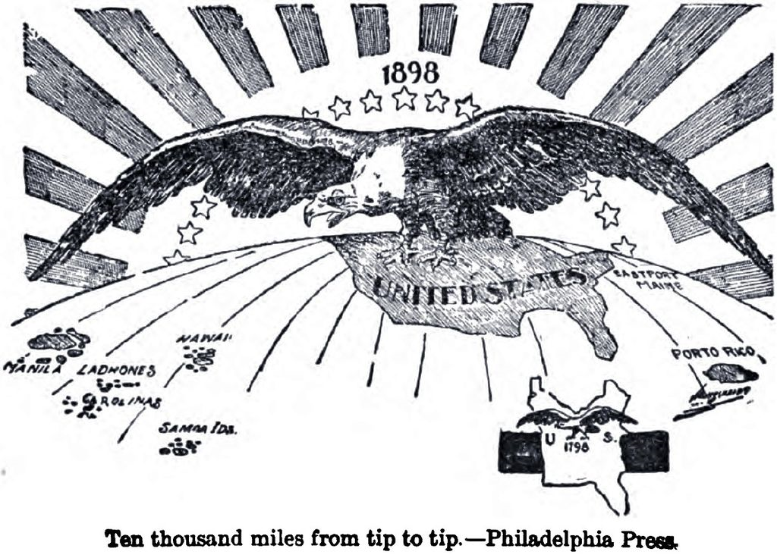
Notes:
http://upload.wikimedia.org/wikipedia/commons/thumb/0/08/10kMiles.JPG/1024px-10kMiles.JPG

Slide 5
Liberty cap
This soft cap evolved as a combination of two earlier symbolic head coverings. The peaked red Phrygian cap was worn in present-day Turkey as early as 800 B.C. and was seen as a mark of free men in classical Greece.
The ancient Roman conical cap called a pileus was placed on the heads of emancipated individuals – who, as slaves, were not allowed to grow their hair or wear a cap – and is often depicted along with a special rod that was used in the ceremony of manumission, when slaves were formally emancipated.
Centuries later, the freedom cap appeared in images during the American Revolution and was used in American art and coins in the early 19th century.
It was most popular during the French Revolution, when it was called the “bonnet rouge” and was worn by revolutionaries and depicted worn or held by a female figure representing Liberty.
Notes:
This soft cap evolved as a combination of two earlier symbolic head coverings. The peaked red Phrygian cap was worn in present-day Turkey as early as 800 B.C. and was seen as a mark of free men in classical Greece. The ancient Roman conical cap called a pileus was placed on the heads of emancipated individuals – who, as slaves, were not allowed to grow their hair or wear a cap – and is often depicted along with a special rod that was used in the ceremony of manumission, when slaves were formally emancipated.
Centuries later, the freedom cap appeared in images during the American Revolution and was used in American art and coins in the early 19th century. It was most popular during the French Revolution, when it was called the “bonnet rouge” and was worn by revolutionaries and depicted worn or held by a female figure representing Liberty.
One of the places that the freedom cap surprisingly does not appear is on the head of the Statue of Freedom atop the Capitol Dome. Although architect Thomas U. Walter’s first drawing for the Dome included a sketch of Freedom holding the pole with the liberty cap, the statue as completed includes no symbols traditionally associated with freedom or liberty. Thomas Crawford, the American sculptor commissioned to create the Dome’s statue, did propose a female figure wearing a liberty cap in his second design, but Captain Montgomery Meigs, who was in charge of the construction of the Capitol extension and new Dome, rightly feared that his superior, Secretary of War Jefferson Davis, would not like it.
http://www.aoc.gov/blog/liberty-cap-art-us-capitol

Slide 6
Notes:
Liberty. In the form of the goddess of youth; giving support to the bald eagle
Savage, Edward, 1761-1817, artist.
CREATED/PUBLISHED 1796.
SUMMARY An allegory of American liberty. Liberty, represented by a maiden in the form of the goddess Hebe, offers a cup to an eagle descending from the upper left. With her right foot she treads on chains, a scepter, a key, and other implements of tyranny. At the lower right, beyond a pedestal or altar, the town of Boston is visible, with lightning in the sky overhead.
NOTES Title appears as it is written on the item.
Painted & Engrav'd by E. Savage.
Philadelphia Pubd June 11, 1796. by E.Savage.
Stauffer II, no. 2761
Taylor, pp. 11-12
Published in: American political prints, 1766-1876 / Bernard F. Reilly. Boston : G.K. Hall, 1991, entry 1796-2.
Published in: American women : a Library of Congress guide ... Washington : Library of Congress, 2001, p. 177.
a handsome rendering of the neoclassical Liberty figure, by American artist Edward Savage, made a few years after the ratification of the U.S. Constitution, represents the young nation struggling to reemphasize the ideals on which it was founded. With the concept of freedom permeating American political and social philosophy and propaganda, who or what did the new country's leaders choose to represent the concepts of nationhood and civic virtue? Abandoned for now was the iconic Indian woman. Instead, a beautiful, young, white, classicized female was invented as an emblem of national values and republican motherhood.
Source: http://memory.loc.gov/ammem/awhhtml/aw05e/aw05e.html

Slide 7
Notes:
http://4.bp.blogspot.com/-pnHYClvvNSo/ThFjVOvUz-I/AAAAAAAAqXI/v6BqNACOCDQ/s640/1790%2Bcoverlet%2B%2BWintertMus.jpg

Slide 8
Notes:
http://1.bp.blogspot.com/_CvDCiEFbNy8/SlDjTn14UTI/AAAAAAAAKSg/qDutOf4Zghk/s400/1.jpg

Slide 9
Notes:
http://marymaguireartandantiques.com/images/SYMBOLOFAMERICAWOMANWFEATHER.gif

Slide 10
Columbia
Wheatley became the first writer to personify the new nation as the goddess
"Columbia"--a feminized reference to Columbus, who was widely recognized as the "father" of America.
By the end of the Revolution, the figure of Columbia was everywhere. Popular songs and poems celebrated her; towns and cities were named for her (most notably the new seat of the federal government, the District of Columbia); and King's College in New York was renamed Columbia University.
The adjective "Columbian" came to function as a kind of shorthand for patriotic allegiance to national ideals.
As they fought to assert their independence, Americans apparently began to desire a new allegorical image to represent their nation
Columbia was usually represented dressed in a white, toga-like gown, wearing a helmet, and carrying a liberty cap on a pole. She was often accompanied by the flag, the eagle, and documents like the Declaration of Independence and the Constitution. She appeared in paintings, statuary, and even on most of the coins produced by the United States Mint through the nineteenth century.
Notes:
In 1775, the African American poet Phillis Wheatley opened the poem she addressed to George Washington with the lines "Celestial choir! enthroned in realms of light, / Columbia's scenes of glorious toils I write." She goes on to describe the goddess Columbia as "divinely fair," with olive and laurel branches in her "golden hair." With these lines, Wheatley's use of the Columbia image is interesting both for its insistence on the goddess's Caucasian looks and for the profound influence it had on American culture.
Scholar John Higham has suggested that Native American imagery may have become problematic because "white Americans were too close to real Indians in the eighteenth century to feel comfortable about identifying with any such personifications, no matter how idealized." In any case, Wheatley's Caucasian Roman goddess struck a chord. Her association with classical antiquity and the values of the Roman republic must have made her appealing to a nation that liked to conceive of itself as "a new Rome." Fearful that profiles of presidents or leaders would smack of imperialism and aristocracy, the young nation instead featured Columbia's profile on its money, accompanied by the word "Liberty."
http://www.learner.org/amerpass/unit04/context_activ-5.html

Slide 11
Notes:
ttp://memory.loc.gov/service/pnp/cph/3a40000/3a46000/3a46100/3a46101r.jpg

Slide 12
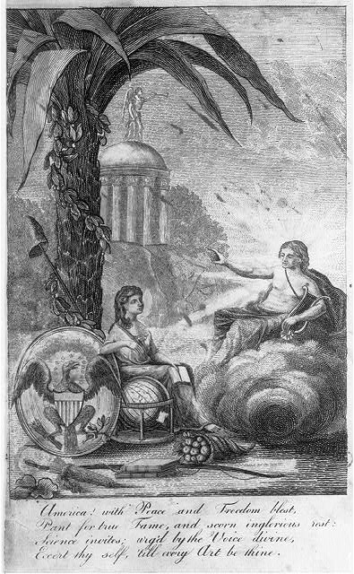
Notes:
http://lcweb2.loc.gov/cgi-bin/query/i?ammem/awhbib:@field(NUMBER+@band(cph+3a45765)):displayType=1:m856sd=cph:m856sf=3a45765

Slide 14
Notes:
http://i.imgur.com/o8Uk7zs.jpg

Slide 15
Notes:
http://2.bp.blogspot.com/_PyAaK20GzDw/TC1ZO1ATfMI/AAAAAAAAClE/1S6lIhZEA5E/s1600/columbia.jpg

Slide 16
Uncle sam
Sam Wilson of Troy, New York supplied pork and beef to the army during the War of 1812
Today the term Uncle Sam is the conglomerate for all government property or the entire government itself.
The cartoon image of Uncle Sam with his red, white and blue suit and hat, tall thin, with a beard did not appear until 1830.
Since Sam Wilson did not have a beard, some say that the beard is from Lincoln.
Congress adopted Uncle Sam as an official symbol in 1961
The first established and well published political cartoonist was Thomas Nast, beginning in the 1870's.
Notes:
He also became a meat inspector. So the barrels of meat he inspected personally and also those from his factory at first "U.States" for United States. Later, just US. But many of the workers were confused, and so when asked what the initials on the meat stood for they said, "Uncle Sam" Wilson, since it was his company. This soon became a common joke. And soldier's began calling themselves (who were eating his meat) Uncle Sam's Army. Soon, all gov't property was stamped with U.S. and termed "Uncle Sam's."
But Uncle Sam's look was actually derived from two earlier figures in American culture: Brother Jonathan and Yankee Doodle. Both figures were used off and on, mostly by political cartoonists from the early 1830's to 1861. Nast gave him his chin with whiskers. The most famous image of Uncle Sam, however is the Army Recruiting poster, painted by James Montgomery Flagg during World War I. That's the one with Uncle Sam looking right at you with his finger pointed saying, "I Want You!" It worked. ;)
Recently, the Uncle Sam image has been criticized as a misrepresentation of what the American culture is today and the diversity of nationalities and cultures. But in 1961 Congress passed a special resolution accepting "Uncle Sam" Wilson of Troy, New York as the namesake behind Uncle Sam. His birthday, September 13 has been proclaimed "Uncle Sam Day" in New York State.

Slide 17
Notes:
http://1.bp.blogspot.com/_kyb7BaggeQ8/TDUvDvazngI/AAAAAAAAADM/trEaBJ6mfgU/s1600/Tenniel610928a-775562.jpg

Slide 18
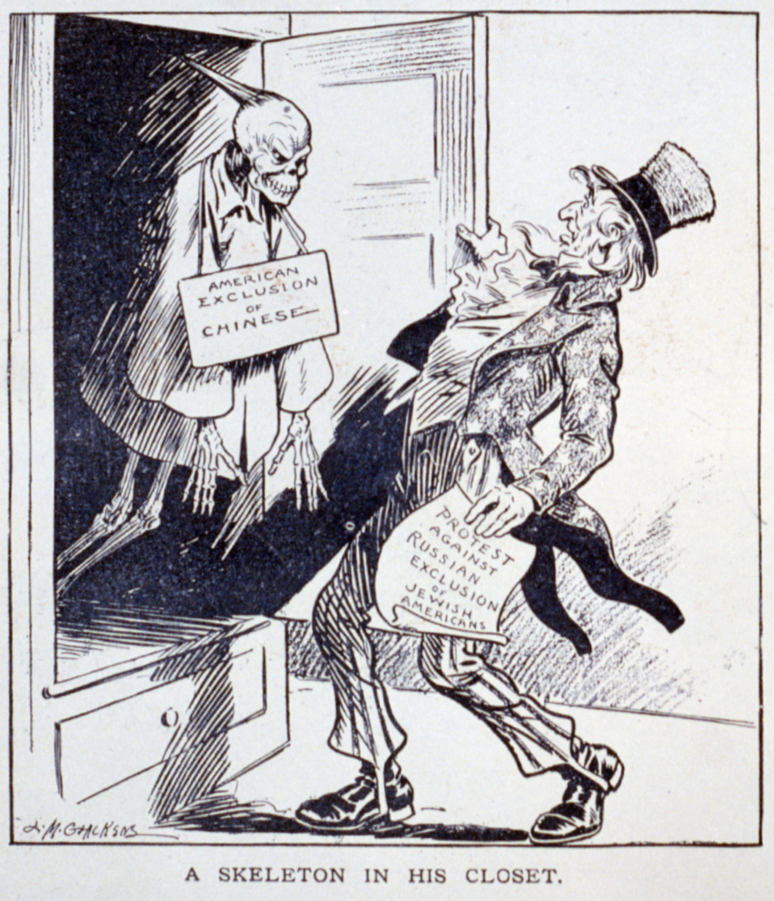

Slide 19
Notes:
http://img.bhs4.com/bc/9/bc972d56229bd1efe55c2085371f5b9601d46036_large.jpg

Slide 20
Great seal
The red and white stripes on the shield “represent the several states all joined in one solid compact entire, supporting a Chief [the blue top of the shield], which unites the whole and represents Congress.
The motto [E Pluribus Unum, Out of Many, One] alludes to this union.”
The colors are adopted from the American flag; “white signifies purity and innocence, red, hardiness and valor, and blue . . . vigilance, perseverance and justice.”
“The olive branch and arrows denote the power of peace and war which is exclusively vested in Congress.”
“The Constellation denotes a new State [or nation] taking its place and rank among other Sovereign powers.”
“The Escutcheon [the shield] is born on the breast of an American Eagle without any other supporters [no other figures that help to hold up the shield] to denote that the United States of America ought to rely on their own Virtue.”
Note also, that the number thirteen representing the first thirteen states is represented in the stripes of the shield, the bundle of arrows and the constellation.
The Back:
“The pyramid signifies strength and duration.”
“The eye over [the pyramid] and the motto [Annuit Coeptis, He (God) Has Favored Our Undertakings] allude to the many signal interpositions of providence in favor of the American cause.”
“The date underneath [MDCCLXXVI, 1776] is that of the Declaration of Independence, and the words under it [Novus Ordo Seclorum, A New Order of the Ages] signify the beginning of the new American era which commences from that date.”
Notes:
The red and white stripes on the shield “represent the several states all joined in one solid compact entire, supporting a Chief [the blue top of the shield], which unites the whole and represents Congress. The motto [E Pluribus Unum, Out of Many, One] alludes to this union.”
The colors are adopted from the American flag; “white signifies purity and innocence, red, hardiness and valor, and blue . . . vigilance, perseverance and justice.”
“The olive branch and arrows denote the power of peace and war which is exclusively vested in Congress.”
“The Constellation denotes a new State [or nation] taking its place and rank among other Sovereign powers.”
“The Escutcheon [the shield] is born on the breast of an American Eagle without any other supporters [no other figures that help to hold up the shield] to denote that the United States of America ought to rely on their own Virtue.”
Note also, that the number thirteen representing the first thirteen states is represented in the stripes of the shield, the bundle of arrows and the constellation.
The Back:
“The pyramid signifies strength and duration.”
“The eye over [the pyramid] and the motto [Annuit Coeptis, He (God) Has Favored Our Undertakings] allude to the many signal interpositions of providence in favor of the American cause.”
“The date underneath [MDCCLXXVI, 1776] is that of the Declaration of Independence, and the words under it [Novus Ordo Seclorum, A New Order of the Ages] signify the beginning of the new American era which commences from that date.”

Slide 21
